Slide 1
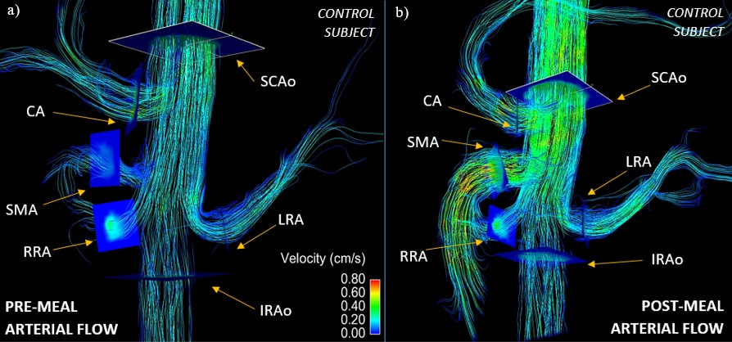
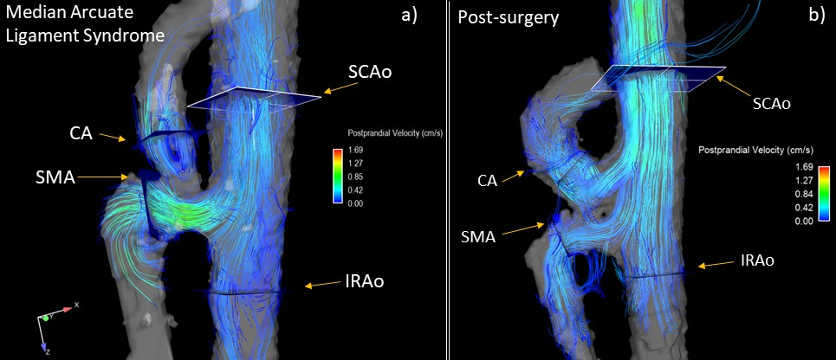

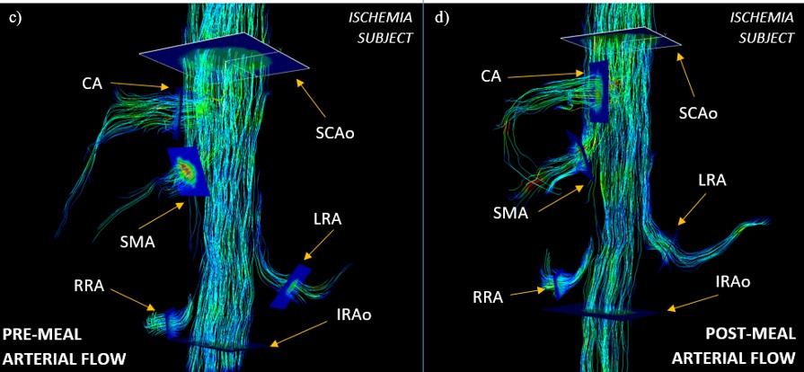
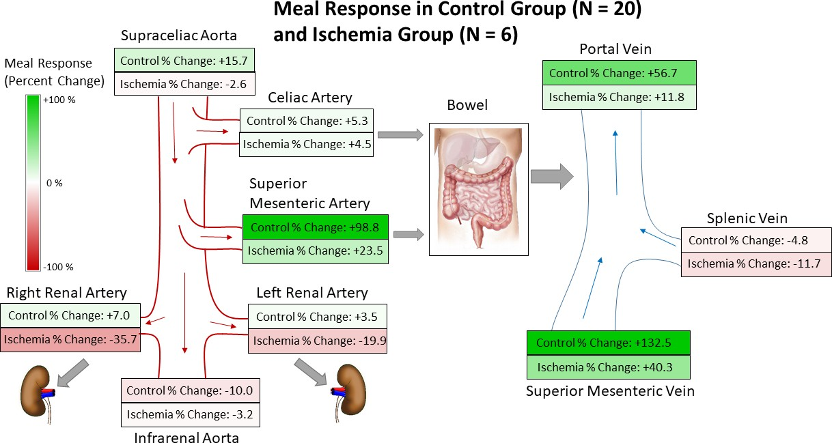
Non-Invasive Assessment of
Mesenteric Hemodynamics with 4D flow MRI
G. Roberts¹, A. Roldán-Alzate², C.J. Francois², and O. Wieben^{1,2}
Departments of ¹Medical Physics and ²Radiology, University of Wisconsin - Madison
PURPOSE
RESULTS (Cont.)
To evaluate the diagnostic capability of 4D flow MRI by comparing post-prandial blood flow response in ischemic patients and healthy volunteers.
One subject with MALS was studied before and after median arcuate ligament release surgery.
INTRODUCTION
Chronic mesenteric ischemia (CMI) is a disease caused by inadequate blood flow to the intestines. Most cases (~90%) are caused by atherosclerosis.
Rare conditions such as median arcuate ligament syndrome (MALS) and aortic dissection may also result in CMI¹.
In healthy individuals, an increase in mesenteric blood flow is observed within minutes after a meal. In patients with CMI, this meal response is compromised.
Due to collateral circulation, patients may not experience symptoms until 2 or 3 major mesenteric vessels are involved¹.
Typical symptoms include:
Severe postprandial abdominal pain after a meal
Weight loss
Nausea/Vomiting
Fear of eating
Functional assessment of mesenteric flow has been traditionally accomplished with invasive interventional angiography and duplex sonography, but has several limitations. Proper diagnosis of CMI remains a diagnostic challenge.
4D flow MRI has been shown suitable to anatomically and functionally evaluate mesenteric vasculature².
Figure 3: Patient diagnosed with MALS. Images are shown before a) and after b) median arcuate ligament release surgery. Image b) shows greatly improved flow after surgery (CA flow increase of 156%).
Using a paired t-test, the SCAo, SMA, SMV, and SV showed a statistically significant flow response (p-values < 0.01) in both the control and negative diagnosis group. No vessels in the ischemia group showed a statistically significant flow response after a meal.
Cross comparing the percent flow change between controls and the ischemic group shows a statistically significant difference in the SCAo (p=0.022), SMA (p=0.003), SMV (p=0.008), and PV (p=0.018) as seen in Table 1. The RRA (p=0.08) and LRA (p=0.06) also showed a notable difference, but not significant. There was no statistically significant difference in percent flow change between the negative diagnosis group and the controls.
Additionally, both the pre- and post-prandial flow values in the SCAo for the ischemia group were less than that of the controls (p=0.034 and p=0.001 respectively).
Interestingly, the pre- and post-prandial flow values in the CA for the negative diagnosis group were less than that of the controls (p=0.003 and p=0.008 respectively).
Figure 1: 4D arterial flow MRI streamline images for a control subject (figures a and b) and an ischemia subject (figures c and d) both before (figures a and c) and after a meal challenge (figures b and d).
METHODS
RESULTS
21 patients (12 females) with a suspicion of mesenteric ischemia, referred from vascular surgery, were imaged on 1.5T and 3.0T scanners (Signa Excite and MR750, GE Healthcare, Waukesha, WI).
Average age: 48.3 years [21 – 86 years]
20 healthy volunteers (8 females) were also imaged.
Average age: 44.4 years [19 – 73 years]
Hemodynamic parameters were measured before and after a meal challenge. All patients received two scans.
The first scan was performed after 5 hours of fasting.
The second scan was performed in the same scan session 20 minutes after ingestion of 574 mL of EnSure Plus (Abbott Laboratories, Columbus, OH)
4D PC MR data were acquired using 5-point PC-VIPR acquisi- tion^{3,4} with retrospective cardiac and respiratory gating.
Complete volumetric coverage of the abdomen was acquired.
32x32x24 cm FOV, 1.25 mm isotropic resolution, VENC = 120 cm/s, scan time = 12 minutes
3D vessel segmentation was performed semi-automatically on the MC MR angiogram using Mimics (Materialize, Leuven, Belgium).
Flow visualization and flow analysis plane placement in 9 vessels was accom- plished in EnSight (ANSYS, Canonsburg, PA) as shown in Fig. 1:
6 Arterial vessels: supraceliac aorta (SCAo), infrarenal aorta (IRAo), superior mesenteric artery (SMA), celiac artery (CA), right renal artery (RRA), and left renal artery (LRA).
3 Portal Vessels: portal vein (PV), splenic vein (SV), and superior mesenteric vein (SMV).
Magnitude and velocity vector data from these 9 planes were exported and analyzed in a customized software package⁵ that allowed for manual vessel segmentation over all frames of the cardiac cycle.
After flow analysis, the clinical diagnosis for each patient was provided and the suspected ischemia group was further subcategorized into 2 groups.
Ischemia (positive diagnosis of ischemia)
Negative Diagnosis
4D flow data were successfully obtained for all 82 flow scans.
Flow changes between pre- and post-meal are summarized in Figure 2 and Table 1.
DISCUSSION & CONCLUSION
The ischemia group showed overall lower flow volumes than control groups in the supraceliac aorta (SCAo) and splenic vein (SV). This is most likely due to globally compromised cardiovascular health.
The ischemia group showed a stunted flow response after a meal challenge, particularly in the SCAo, SMA, SMV, and PV. This is most likely due to the intrinsic pathology preventing mesenteric vessels from fulfilling demand for increased blood flow to the abdomen.
The flow values in the CA for the negative diagnosis group is likely lower due to narrowing of the CA present in some patients.
Visualization of anatomy and flow patterns can further aid in diagnosis by identifying patient-specific pathology (Figure 3).
This study demonstrates a quantifiable difference in blood flow response between (1) ischemic patients and (2) healthy patients and volunteers after a meal challenge.
Follow-up studies with larger patient cohorts are warranted to investigate the clinical utility of 4D flow MRI as a diagnostic and therapy marker for patients with symptoms of mesenteric ischemia.
Figure 2: Comparison of meal challenge response between the control group and the ischemia group.
REFERENCES
Wilkins LR, Stone JR. Chronic mesenteric ischemia. Tech Vasc Interv Radiol. 2015;18(1):31-37.doi:10.1053/j.tvir.2014.12.005
Roldan-Alzate A, Frydrychowicz A, Said A, et al. Impaired regulation of portal venous flow in response to a meal challenge as quantified by 4D flow MRI. J Magn Reson Imaging. 2015;42(4):1009-1017. doi:10.1002/jmri.24886
Gu T, Korosec FR, Block WF, et al. PC VIPR: A high-speed 3D phase-contrast method for flow quantification and high-resolution angiography. Am J Neuroradiol. 2005;26(4):743-749. doi:26/4/743
Johnson KM, Lum DP, Turski PA, et al. Improved 3D Phase Contrast MRI with Off-resonance Corrected Dual Echo VIPR. Magn Reson Med. 2008;60(6):1329-1336. doi:10.1002/mrm.21763.Improved
Magn Reson Med. 2008 Nov;60(5):1218-31. doi: 10.1002/mrm.21778. Quantitative 2D and 3D phase contrast MRI: optimized analysis of blood flow and vessel wall parameters. Stalder AF1, Russe MF, Frydrychowicz A, Bock J, Hennig J, Markl M.
Table 1: Average percent change of blood flow in response to a meal challenge is shown for all three cohorts for each vessel. The negative diagnosis group and ischemia group were compared to the control data set using a t-test. Yellow indicates statistical significance (p < 0.05).
ACKNOWLEDGEMENTS
We acknowledge GE Healthcare for their assistance and support.

